Slide 1
Lab 6: Display XY DATA AND Geocoding

Slide 2
Objective
Display XY Data
Data Table contains “latitude and longitude information” OR “X-coordinates and Y-coordinates” information
Geocoding
Data Table contains “address list”

Slide 3
Part I: Display XY Data
In this tutorial, we will use the 1998 EPA Toxic Release Inventory Sites (TRI) throughout Western New York. This data was acquired from the EPA’s website and contains data for the entire state of New York.

Slide 4
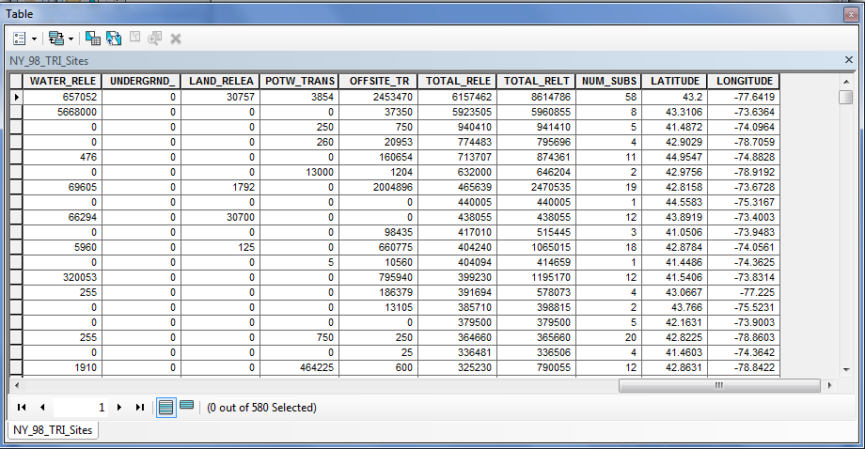
Let’s begin by opening ArcMap and adding NY_98_TRI_Sites.dbf.
Notice that the data set contains 580 records for hazardous facilities in NY state. The last two fields contain Latitude and Longitude values. We will use these fields to spatially display the data.

Slide 5
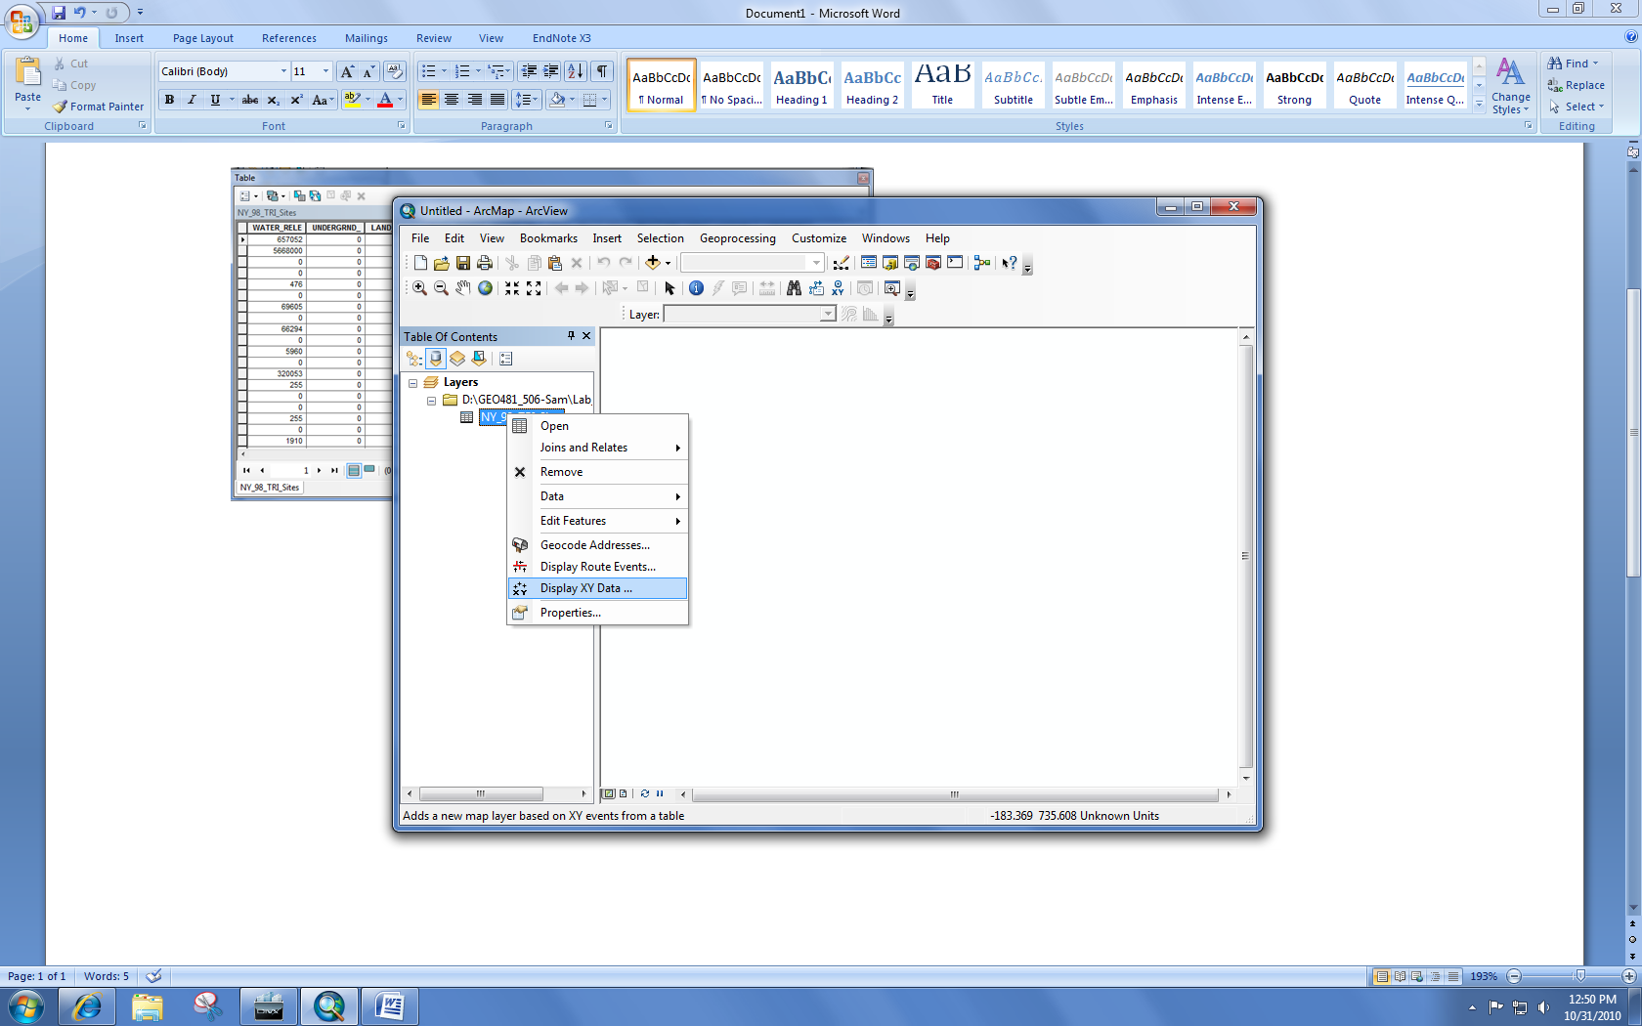
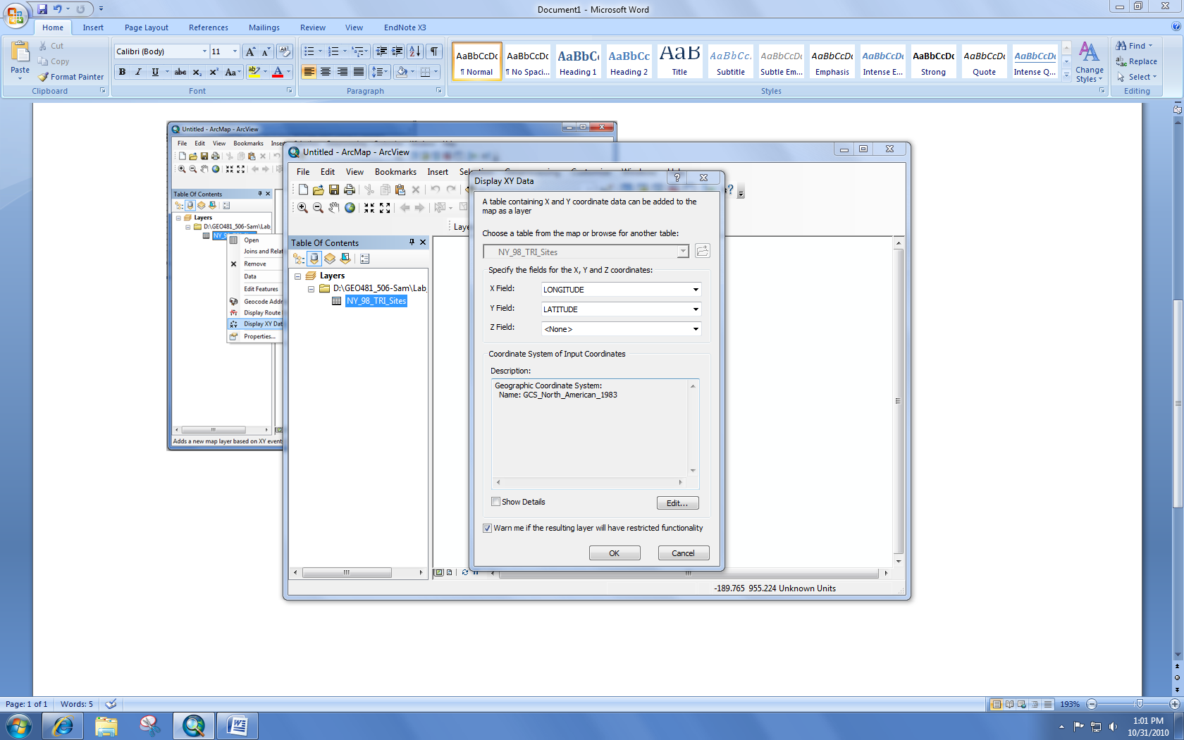
Right click on NY_98_TRI_Sites -> “Display XY Data”
X is Longitude; Y is Latitude.
Edit the Unknown Coordinate System to be GCS_North_American_1983 (the same as the coordinate system of the NY_Counties layer).
Edit-Select-Geographic Coordinate System - North America - NAD 1983.prj-Add-OK

Slide 6
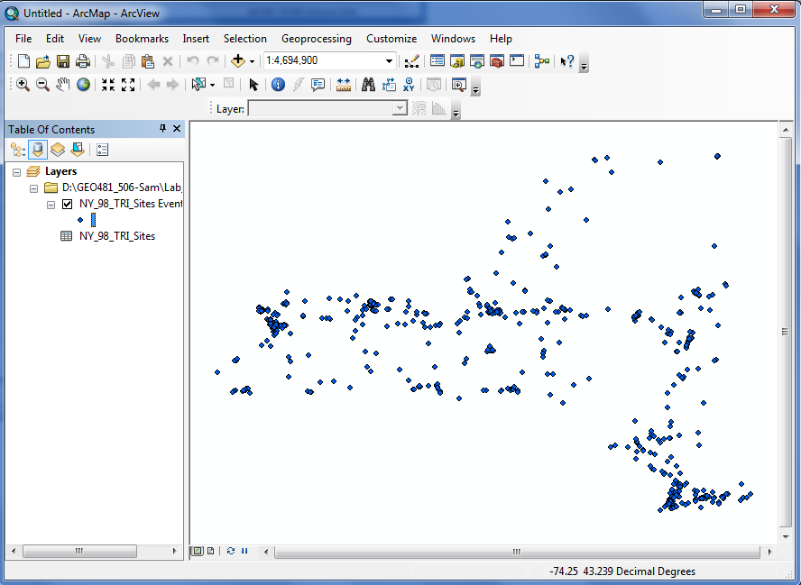
With the geographic coordinate information, the Toxic Release Inventory Sites (TRI) can be shown in the window.

Slide 7
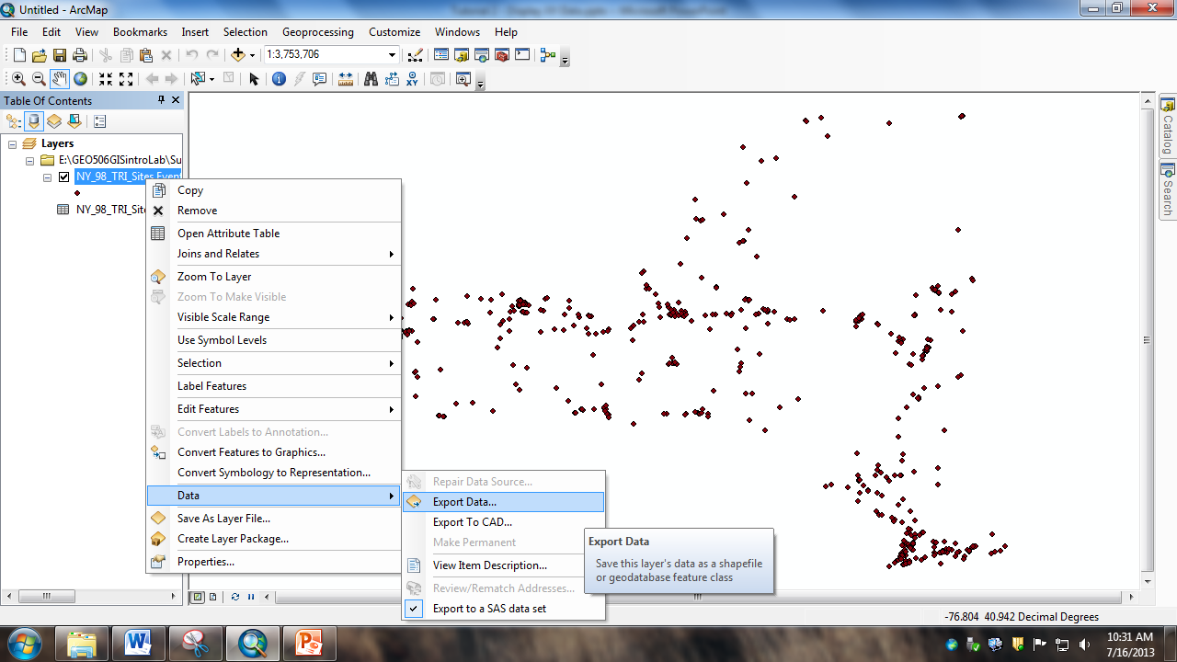
However, this NY_98_TRI_Sites Events file is temporary, you can’t use it further as input for other analysis. Rather, you need to export it as a separate file for future use.

Slide 8
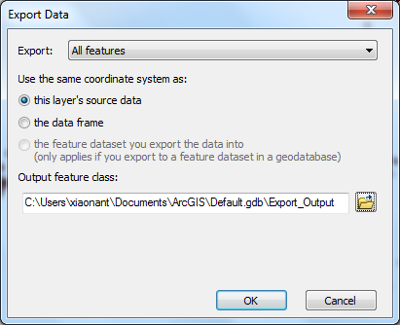
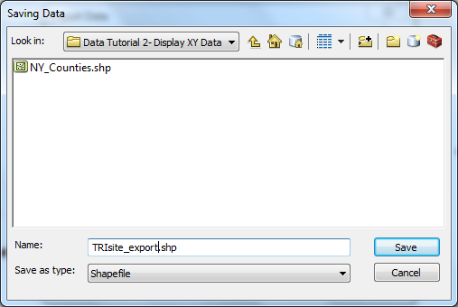

Slide 9
Part II: Geocoding
Geocoding is the process of transforming a textual description of a location (such as an address) to a location on the earth's surface (point feature).
For example, an address usually contains a street name and number.
The geocoding process will allow us to assign coordinates to the address.

Slide 10
Part II: Geocoding
Address List
(what we are geocoding)
Reference Data
Address Locator
Geocoded Points

Slide 11
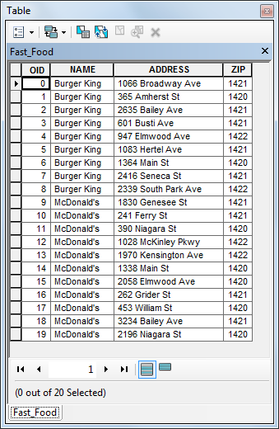
We begin with an address list.

Slide 12
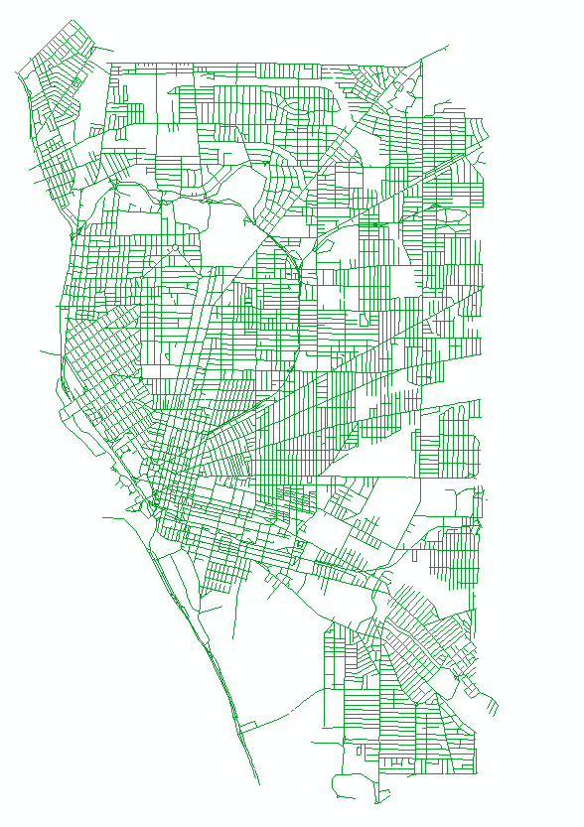
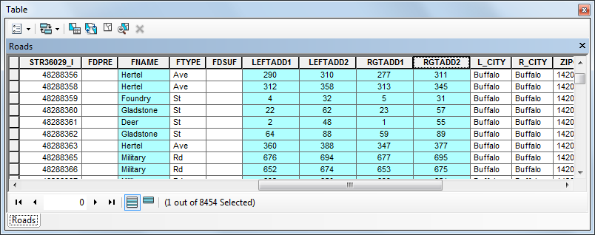
We now need reference data in which to locate the addresses.
A typical reference data is a streets shapefile.
Many streets shapefiles contain such information as;
Street Names
The arrangement of addresses on the streets
e.g. Dual Range is one type of arrangement;
In Dual Range, one side of the street has odd-numbered addresses
and the other side of the street has even-numbered addresses.
On each side of the street, the address is represented by a range.
e.g. 738 - 778 Piedmont Ave on the even side of the street.
739 - 779 Piedmont Ave on the odd side.

Slide 13
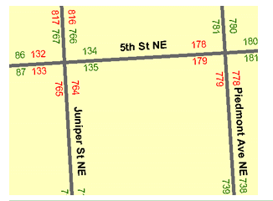
We need to identify an address locator style, such as Dual Range. We must be sure that this style is compatible with the arrangement style of the reference data.
In practice, creating the Address Locator is the first step.
742 Piedmont Ave would be located on the right side of the street between 738 and 778, but closer to 738. Given this input address, a reference data, and an address locator, we are now able to plot it’s location.

Slide 14
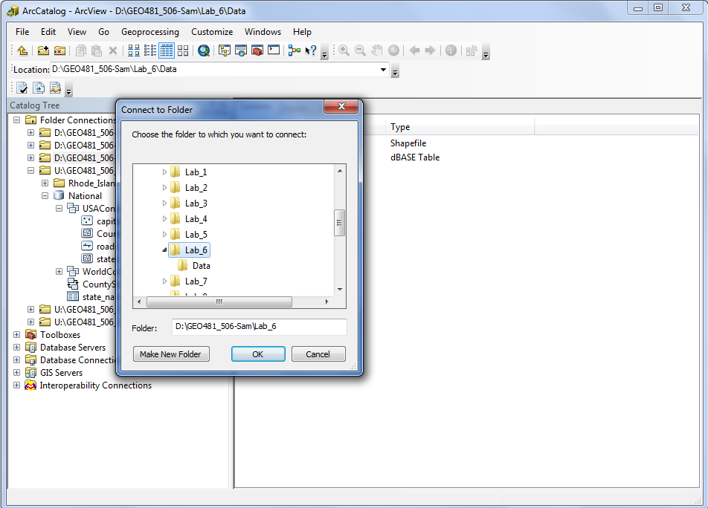
Open ArcCatalog, connect to your data folder.

Slide 15
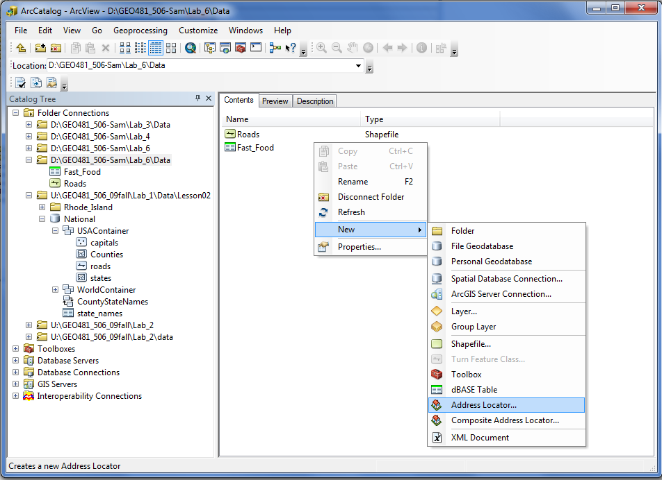
We will begin by choosing the Address Locator Style.
In your Tutorial 2 data folder, right-click in the content window and navigate to “New” -> “Address Locator.”

Slide 16
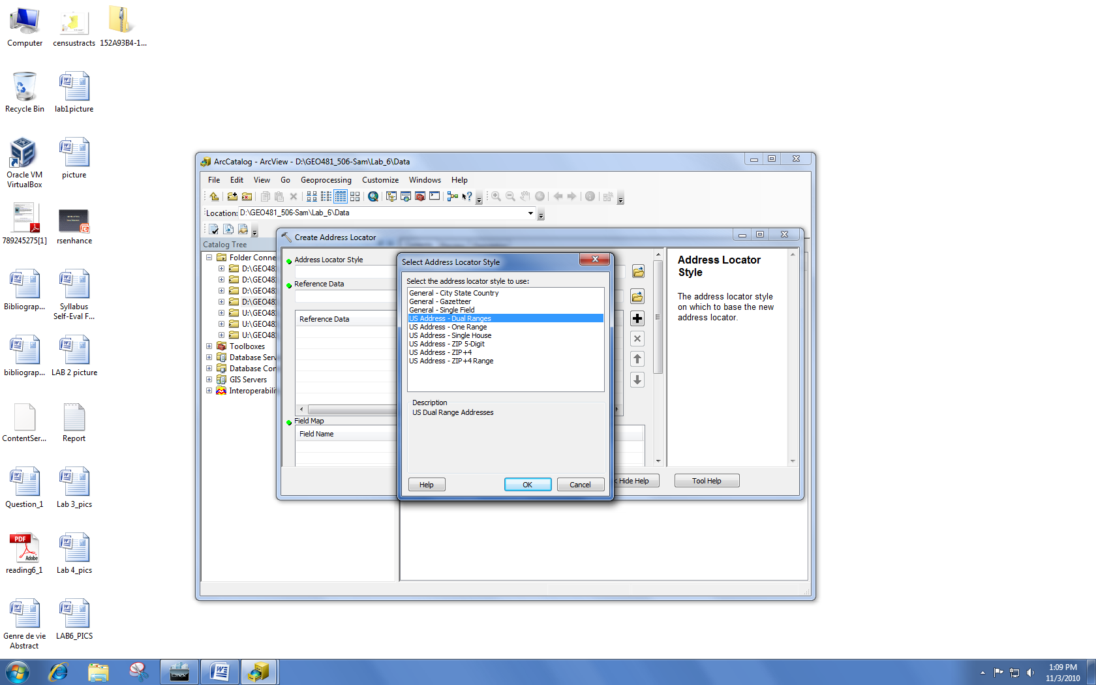
Select Address Locator Style -> US Address – Dual Ranges -> click OK

Slide 17
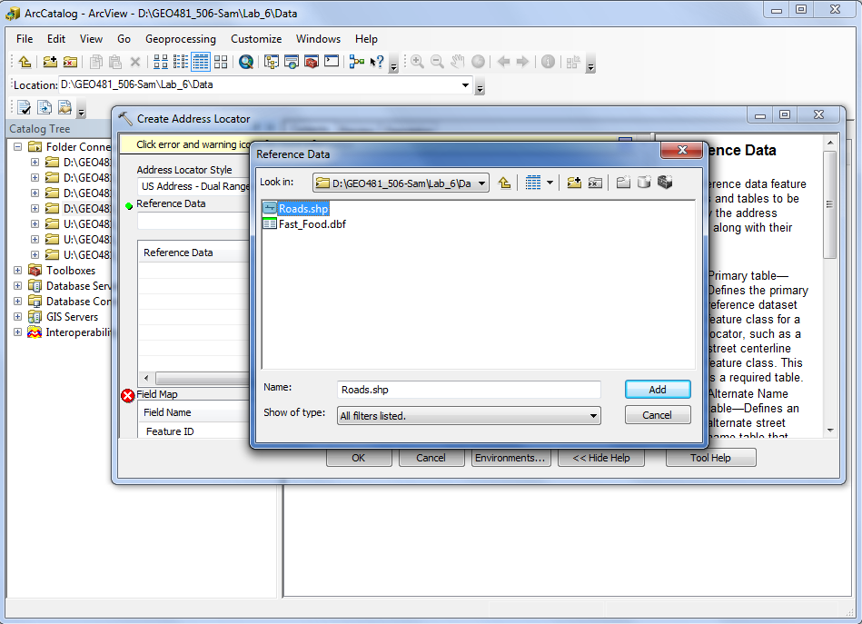
We next choose our Reference Data.
Under ‘Reference data:’ click the browse button -> find Roads.shp -> click add. ArcCatalog now populates the Roads.shp fields. The fields with * are required. Once they are filled in, click OK.

Slide 18
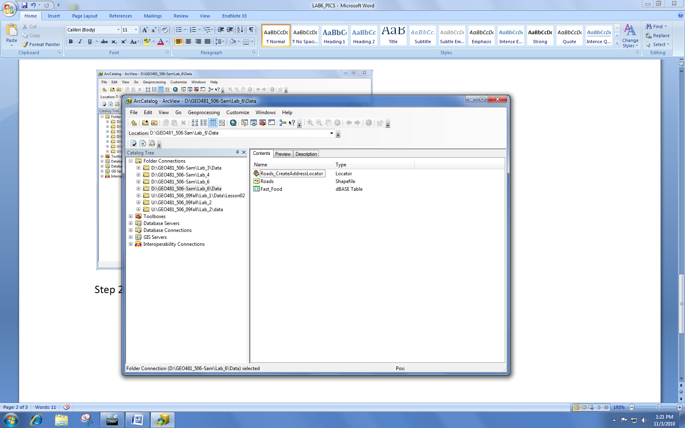
The remaining defaults are good -> click OK.

Slide 19
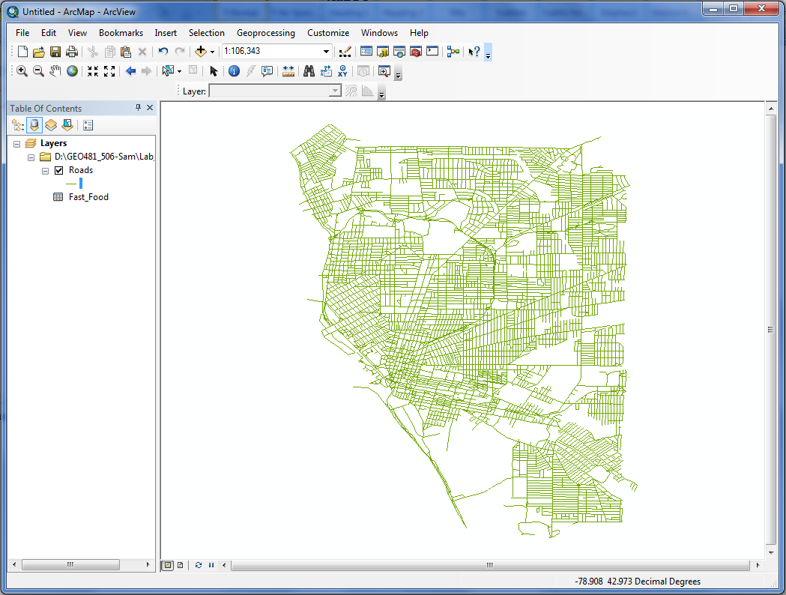
Launch ArcMap. In ArcMap, add Roads.shp (Reference Data) and Fast_Food.dbf (Address List).

Slide 20
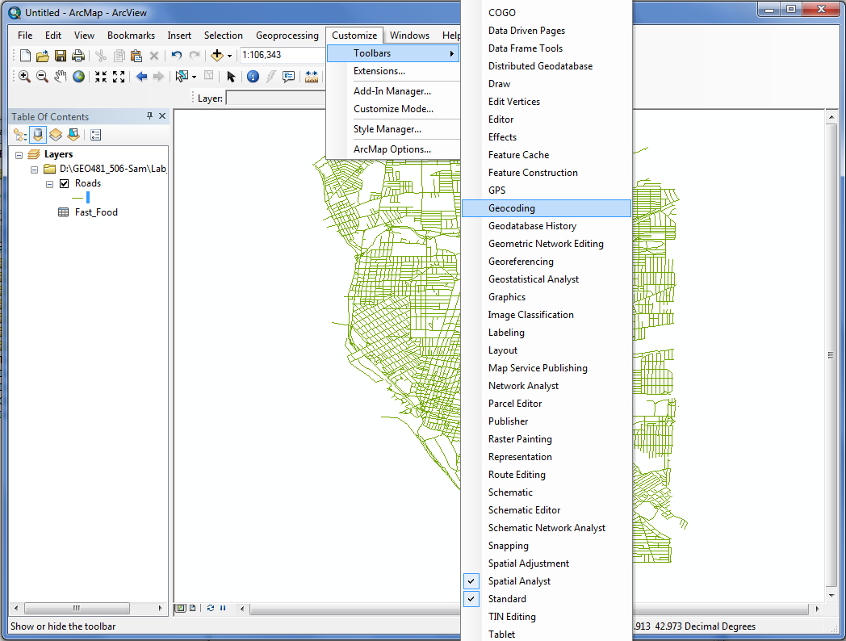
We will now add our newly created Address Locator.
Click on the ‘Customize’ menu -> Toolbars -> Geocoding. In the dropbox of Geocoding, choose <Manage Address Locators…>

Slide 21
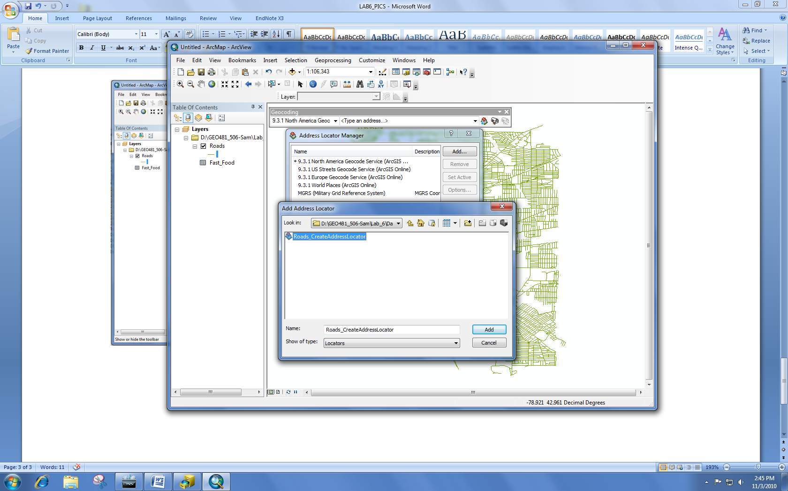
Click Add -> in the dropdown, click “Roads_CreateAddressLocator” -> click Add click Close

Slide 22
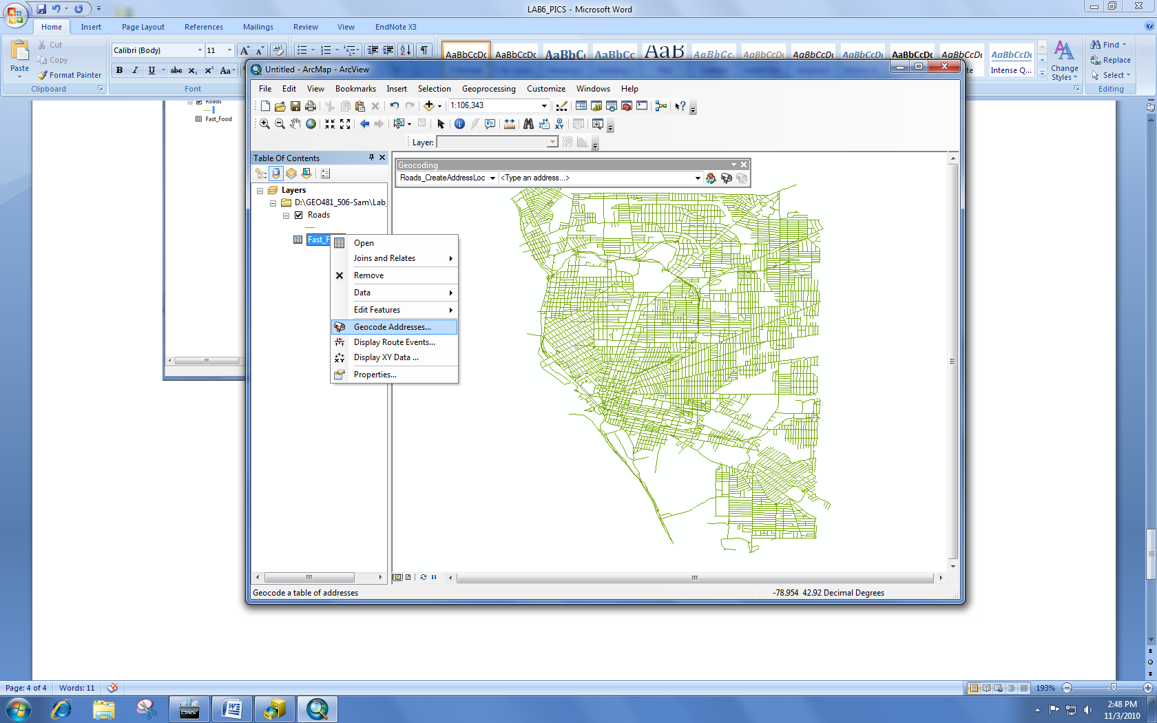
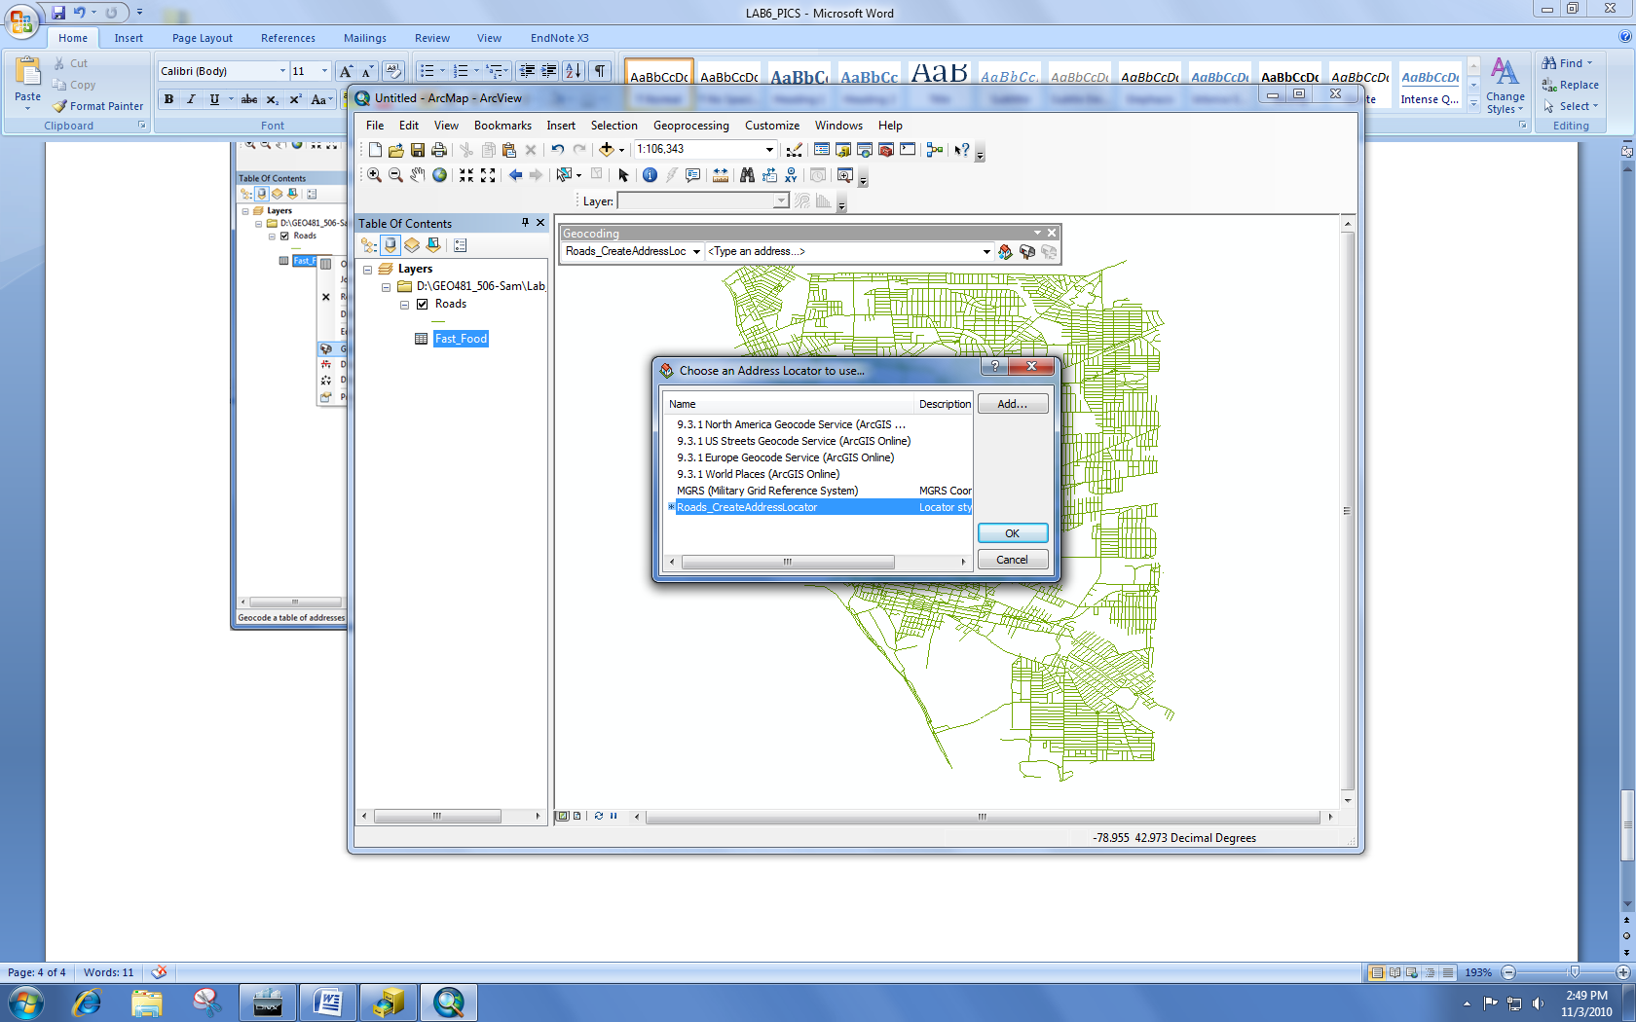
We can finally Geocode the fast food addresses.
In the table of contents, under the view by source tab, right click on Fast_Food.dbf -> click “Geocode Addresses.”
In the dialogue box, select “Roads_CreateAddressLocator” -> click ok.

Slide 23
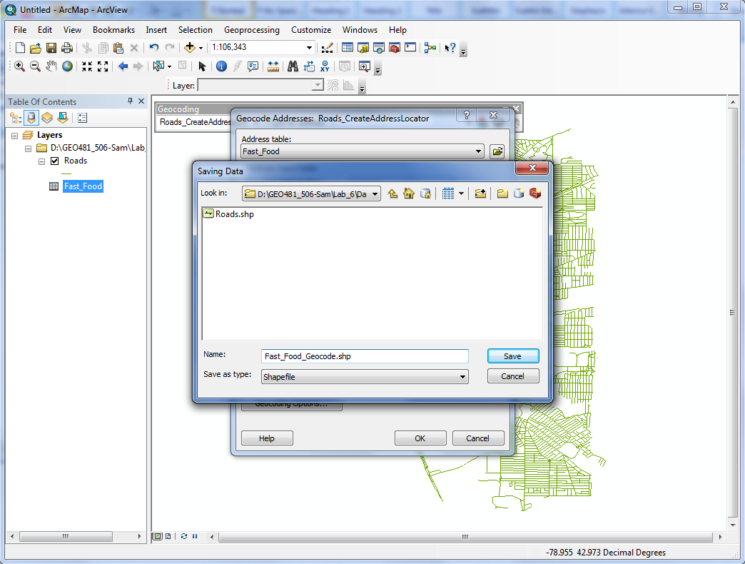
Name the output;
In the next dialogue box, click browse next to the “Output shapefile or feature class:”.
Save the file as Fast_Food_Geocode.shp. Change the “Save as type:” to shapefile.
Click OK

Slide 24
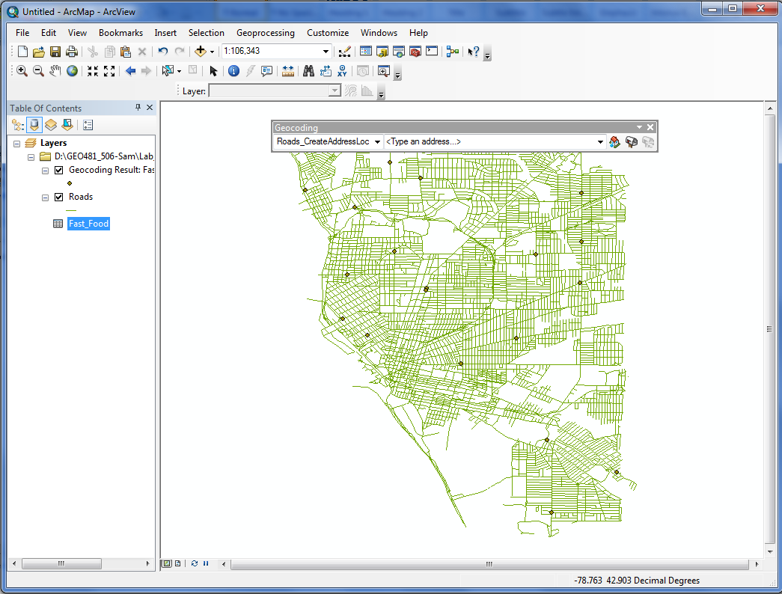
ArcGIS will geocode the addresses and create “Fast_Food_Geocode.shp.”

Slide 25
Ncsv add atr ac
Sag tus yap display xy long lat
Koordinat sistemi ata
Export et
Step 2
Available real estate I ac yeni layer olarak
Geo pro yapacan sonar
Ref data olarak raosd aekle
Full name lftoadd gibi 4 feature kullan
Arc catalog ac ve ad locator yap
Locator da problem cikarsa fullnem street name I sec hata kaybolasun
Step3
Butun layer lari Gcs den project system donusutr
Arc catalog ac
Projections and trans
Project I sec
North American dan nad e donustur.
Step 4
Buffer yap
Step 5
Select real estate select by locationi kullan ve map yap
Project da zone utm den nad zone
18 I secti. Projected data ya doinustururken
Buffer yaparken new scvhollas 100 metre secti all u secti birde.
Are completely within so target layer real estate secti
100 metre disindakileri ayrica kaydetti yildiz isareti koydu
Aynisini 500 icin
Busefer select by loca select 100 hunder buffer target layer yapti
Sanirim hepsinde bir onceki buffer I sececen ki overlap olmasin.
Sadece erie county kendi haritadanda gosterecen

